Slide 1

ERM ESG Ratings Working Group 2026
Session 4
June 24, 2026

Slide 2
Today’s conversation
Welcome & overview
        Scene setting for the meeting
In conversation with MSCI
        Welcome Julia Wilson, Lauren Wisbeski, and Balazs Bogdan
      3 Member-only discussion
        A conversation among members
4 Looking ahead to the next session
        Preparation for July 29 with EcoVadis

Slide 3
Anti-trust disclaimer
We want discussions to proceed in line with everyone’s respective anti-trust obligations ​
As a general matter, international anti-trust laws prohibit competitors from agreeing on the prices they will charge, the products they will offer, the customers they will serve, the suppliers they will use, what is negotiated with either upstream or downstream market suppliers/distributors, and the markets in which they will compete.​
Both “vertical” and “horizontal” anti-trust discussions are not allowed, with a vertical scheme up and down a supply line and a horizontal scheme is between direct competitors (or their representatives). ​
Therefore, while you can discuss risks and concerns, there should be no discussion or disclosure of information with respect to anti-competitive practices, including but not limited to:​
      Profits, premiums, prices, surcharges, rebates or discounts;​
      Specific customers or classes of customers or whether you will or will not do business with them;​
      Allocation of geographic or product markets;​
      Any refusal to deal with a customer or supplier; or​
      How to deal with the market behavior of a competitor.​
​

Slide 4
Housekeeping
Remember, you have control if you are on video or not. We always invite you to be on video when you speak.
Please introduce yourself when you come off mute to speak. ​
​

Slide 5
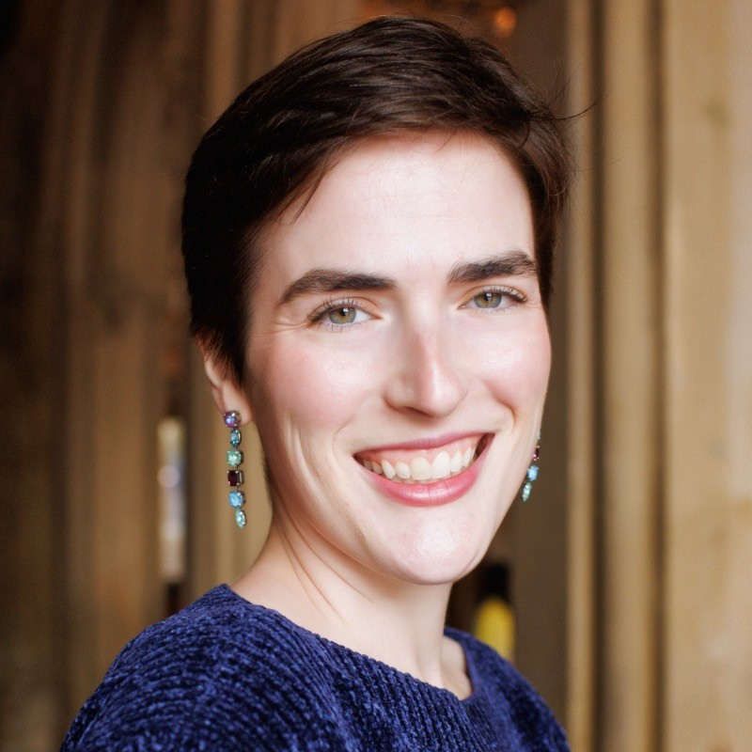
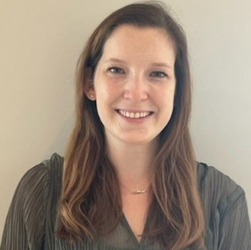
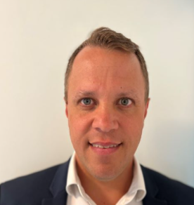
Who you’ll hear from today
Julia Wilson
Lauren Wisbeski
Balazs Bogdan
Executive Director, Corporate Solutions R&D Lead
MSCI
Senior Associate, Issuer Relations
MSCI
VP Sustainability & Climate Product, Corporates
MSCI

Slide 6
Member-only discussion
An open forum among working group members

Slide 7

Current events in the ESG landscape
A discussion on the most pertinent events impacting our Working Group members
CDP splits into two entities & announces significant investment from PE firm
CDP launches AI-powered adaptation & action explorer to help subnational governments turn climate risk into action
SBTi finalizes long-awaited update to its Corporate Net-Zero Standard
Governance surpasses environment as top ESG reputational risk in 2026, GlobeScan survey suggests
ERM & the Sustainability Institute Updates:
  Report: Global Regulations Radar, 5th edition
  Policy alert: Integrated transition planning: business case, early steps, actions and guidance
  ERM at London Climate Week
      Blog on 4 themes

Slide 8

Next up:
July 29th

Slide 9

Mark Lee
Global Director, Thought Leadership, ERM
Mark.Lee@erm.com
Catherine (Katie) Osborn
Associate Partner, ERM
Catherine.Osborn@erm.com
Kristin Siepker
Manager, Project Administration, ERM
Kristin.Siepker@erm.com
Katie Langemeier
Research & Consulting Senior Associate, the ERM Sustainability Institute
Katie.Langemeier@erm.com

