Slide 1

ERM ESG Ratings Working Group 2026
Session 5
July 29, 2026

Slide 2
Today’s conversation
Welcome & overview
        Scene setting for the meeting
In conversation with EcoVadis
        Welcome Bettina Grabmayr
      3 Member-only discussion
        A conversation among members
4 Looking ahead to the next session
        Preparation for September 16 with BCI

Slide 3
Anti-trust disclaimer
We want discussions to proceed in line with everyone’s respective anti-trust obligations ​
As a general matter, international anti-trust laws prohibit competitors from agreeing on the prices they will charge, the products they will offer, the customers they will serve, the suppliers they will use, what is negotiated with either upstream or downstream market suppliers/distributors, and the markets in which they will compete.​
Both “vertical” and “horizontal” anti-trust discussions are not allowed, with a vertical scheme up and down a supply line and a horizontal scheme is between direct competitors (or their representatives). ​
Therefore, while you can discuss risks and concerns, there should be no discussion or disclosure of information with respect to anti-competitive practices, including but not limited to:​
      Profits, premiums, prices, surcharges, rebates or discounts;​
      Specific customers or classes of customers or whether you will or will not do business with them;​
      Allocation of geographic or product markets;​
      Any refusal to deal with a customer or supplier; or​
      How to deal with the market behavior of a competitor.​
​

Slide 4
Housekeeping
Remember, you have control if you are on video or not. We always invite you to be on video when you speak.
Please introduce yourself when you come off mute to speak. ​
​

Slide 5
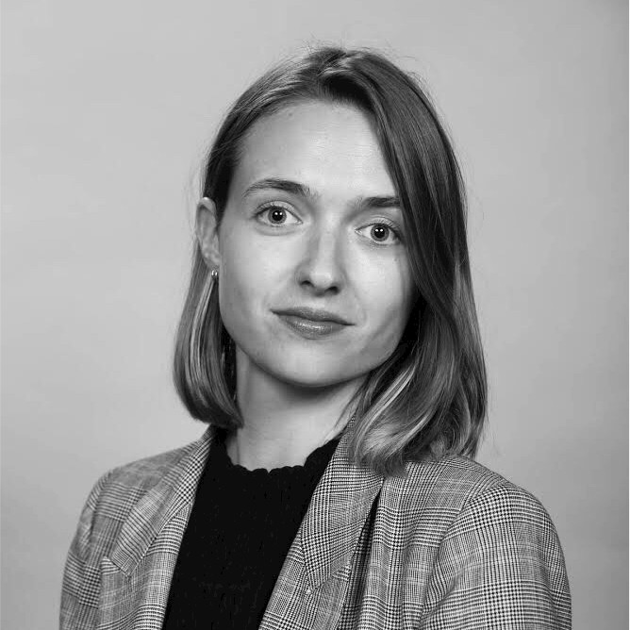
Who you’ll hear from today
Bettina Grabmayr
VP Methodology & Research
EcoVadis

Slide 6
Member-only discussion
An open forum among working group members

Slide 7

Current events in the ESG landscape
A discussion on the most pertinent events impacting our Working Group members
EU Commission adopts revised sustainability reporting standards
Morningstar Sustainalytics Enhances Physical Climate Risk Capabilities with AI partnership
CDP Disclosure 2027: shorter cycle. beginning sooner
      Response window opens April 14, deadline for scored responses June 23
      Final response deadline August 25
      Response window is 1 month shorter than previous years
      Discussion: Any reactions to the new CDP disclosure timeline? How are we thinking about adjusting plans to meet it?
ERM & the Sustainability Institute Updates:
  Report: June Quarterly Trends
  Blog: Trellis Impact 26 Insights: Where Innovation Powers Sustainable Business
  Council on Sustainability Transformation White Paper: From Silo to System: Connecting sustainability to the core of business
  Upcoming: New York Climate Week calendar

Slide 8


Next up:
September 16
October 21
Notes:
I'll be missing again as I will be getting married in September

Slide 9

Mark Lee
Global Director, Thought Leadership, ERM
Mark.Lee@erm.com
Catherine (Katie) Osborn
Associate Partner, ERM
Catherine.Osborn@erm.com
Kristin Siepker
Manager, Project Administration, ERM
Kristin.Siepker@erm.com
Katie Langemeier
Research & Consulting Senior Associate, the ERM Sustainability Institute
Katie.Langemeier@erm.com

